Slide 1
D3-D4 – Meeting
12/01/2024
Henri HAPPY
https://edengsys.univ-lille.fr
https://edengsys.univ-lille.fr/en/

Slide 2
D3 - Meeting program
Introduction
Thesis defence
Thesis committee
The thesis oath
D4 registration – derogatory regime
After PhD
Professional carreer in public sector

Slide 3
General introduction – Objectives of D3Day
Exchange with on your last year of PhD thesis
End of a process (doctoral student)
Continuation of your professional career (actually:
limited-term employement contract)
End of the contracts: from october to december)
Give you practical information to prepare your thesis defence in the best conditions
Novelty: The thesis oath
Professional carreer: data on professional integration

Slide 4
Introduction: Writing a thesis
Writing a thesis:
A job in itself
Requires motivation and organization
Establish a precise plan to meet deadlines
Organization of thesis defence
Contact Ms. NGUYEN
Mail - Phone
Work in coordination with your supervisor and your DED
The thesis defence is managed via ADUM
Avoid errors in the contact information of the jury members
Do not hesitate to ask your thesis supervisor to validate your thesis jury in ADUM

Slide 5
D3 - Meeting program
Introduction
Retro-planning for thesis defence
Thesis committee
The thesis oath
D4 registration – derogatory regime
After PhD
Professional carreer in public sector

Slide 6
PhD defence: retro-planning
D – 9 weeks : Student submits the committee to GS ENGSYS via ADUM
D – 8 weeks : Graduate School ENGSYS checks the required CFD, the validity of the committee and gives its agreement
D – 8 weeks : Student uploads the manuscript in ADUM, and sends a copy to the reviewers and to other committee members
D – 4 weeks : Reviewers send their review to the Institution and to the GS ENGSYS via ADUM
D – 3 weeks : GS ENGSYS Leader and Research President of the Institution give their agreement about PhD defence
Defence : Committee President sends the defence report (written in French and translate in English for foreign students) to the Institution
D + 2 months max : Student sends the final version of the thesis to the Institution
This procedure excludes vacation periods, when the administration is closed

Slide 7
Jury for full time of CIFRE PhD
Must be accreditated (HDR). A full professor or french research director is accreditated. Foreign reviewer’s CV is required.
2 reviewers
(minimum)
Must be outside ENGSYS, IMT, ULille, CLille and Uge-COSYS. Must be outside doctoral project. No work and papers with supervisors and PhD student during PhD duration.
More than 50% of members are outside ENGSYS, IMT, ULille, CLille and UGE More than 50% of members are outside doctoral project.
All members must be PhD.
More than 50% of Full Professor or equivalent (Research Director in France).
From 4 to 8 committee members
Member categories: 1 or 2 supervisors (registered at ADUM), 2 reviewers and examiners
At least 1 member of each gender for a committee with 4, 5 or 6 members.
At least 2 members of each gender for a committee with 7 or 8 members.
All the members can participate via video-meeting (specific agreement).

Slide 8
Jury for co-agreement with foreign institution
Must be accreditated (HDR). A full professor or french research director is accreditated. Foreign reviewer’s CV is required.
2 reviewers
(minimum)
Must be outside ENGSYS, IMT, Ulille, Clille, UGE and the foreign institution. Must be outside doctoral project. No work and paper with supervisors and PhD student during PhD duration.
More than 50% of members are outside ENGSYS, IMT, ULille, CLille, UG Eiffel and the foreign institution. All members must be PhD.
More than 50% of Full Professor or equivalent (Research Director in France).
From 4 to 8 committee members
Member categories: 1 or 2 supervisors (registered at ADUM), 2 reviewers and examiners
At least 1 member of each gender for a committee with 4, 5 or 6 members.
At least 2 members of each gender for a committee with 7 or 8 members.
All the members can participate via video-meeting (specific agreement).

Slide 9
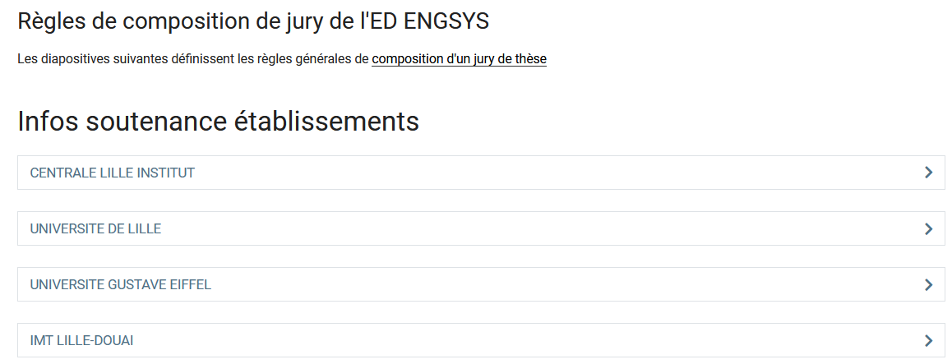
Thesis defence: additional and specific information on website
https://edengsys.univ-lille.fr/pendant-le-doctorat/soutenance
Each institution has its own rules
You must be registered to submit a jury in ADUM

Slide 10
New: The thesis oath
After the deliberation of the jury, in case of success, you are invited by the president of the jury to take the doctoral oath.
The text (in Fr and EN) will be provided by your institution with thesis documents
The oath has a strong symbolic vocation. Its practice is anchored in a legal framework and morally commits the doctor, who can invoke it to refuse to carry out actions that are in tension with the principles of scientific integrity
Le serment revêt une forte vocation symbolique. Sa pratique est ancrée dans un cadre légal et engage moralement la docteure ou le docteur, qui peuvent l'invoquer pour refuser d'effectuer des actions en tension avec les principes de l'intégrité scientifique

Slide 11
D3 - Meeting program
Introduction
Retro-planning for thesis defencse
Thesis committee
The thesis oath
D4 registration – derogatory regime
After PhD
Professional carreer in public sector

Slide 12
D3 Individual monitoring committee (CSI)
For the majority of CSI, everything is going very well
Take this opportunity to mention any problems before they become critical (DEDs – GS) – (During the face-to-face meeting with the jury)
Some confidential information are transmitted only to the director of doctoral school
Our mission in mediation is to protect you (your rights).
Confidential contact if needed:
https://edengsys.univ-lille.fr/news/maison-de-la-mediation-a-luniversite-de-lille

Slide 13
D3 Individual monitoring committee (CSI)
For all D4 registration, an Individual Monitoring Committee (D3-CSI) is set up
(before November)
At minimum the committee includes
One non-specialist member from outside the research field
One member who is a specialist in the discipline or related to the thesis area
One member of the Graduate School ENGSYS (DED) who chairs the D3 CSI meeting
Interview with committee based a common template ( ~8 slides )
At the end of the meeting, a collective report will be written under the authority of DED. This report is posted in ADUM
See on web site: https://edengsys.univ-lille.fr

Slide 14
D3 Individual monitoring commitee (CSI)
Expected results :
Justification for the extension request
Precise timetable for the end of the thesis (retro-planning)
At the request of the DED, the current status of the thesis
manuscript (send copy of the manuscript as is).
Attestation of funding until the defence
The thesis defence date - Jury

Slide 15
D3 - Meeting program
Introduction
Retro-planning for thesis defencse
Thesis committee
The thesis oath
D4 registration – derogatory regime
After PhD
Professional carreer in public sector

Slide 16
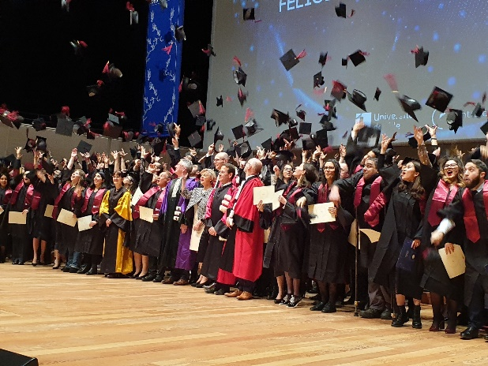
Preparation for further career development
The day after
Tomorrow
Today
Inquiry
Prepare
Get started
Notes:
Fixed term contract

Slide 17
The challenges of tomorrow
Why do we need a PhD?
Need for highly competent young women and men to solve today's challenges
Notes:
Un nouveau programme mondial audacieux pour éradiquer la pauvreté d’ici à 2030 et poursuivre un avenir durable a été adopté vendredi à l’unanimité par les 193 Etats membres des Nations Unies.
« Nous embarquons ensemble sur la voie du développement durable, pour nous consacrer collectivement à la poursuite du développement mondial et d’une coopération mutuellement bénéfique, susceptible d’apporter d’énormes gains à tous les pays et toutes les régions du monde », affirme la Déclaration adoptée par les Etats membres.
Des dizaines de dirigeants mondiaux étaient présents vendredi dans l’enceinte de l’Assemblée générale de l’ONU, à New York, pour participer au Sommet des Nations Unies sur le développement durable, qui se déroulera jusqu’au 27 septembre et s’est ouvert avec cette adoption formelle d’un nouveau programme de développement pour les 15 prochaines années.
« L’adoption historique du nouveau Programme de développement durable, qui s’appuie sur 17 objectifs globaux, a été accueillie par une ovation de la part des délégations, qui comprenaient un grand nombre des plus de 150 dirigeants mondiaux amenés à s’exprimer dans le cadre du Sommet », s’est félicité un porte-parole des Nations Unies dans un communiqué de presse.
Intitulé « Transformer notre monde : le Programme de développement durable à l’horizon 2030 », le programme comporte 17 Objectifs de développement durable (ODD), conçus pour parachever d’ici à 2030 les efforts entamés dans le cadre des Objectifs du Millénaire pour le développement (OMD). Ces derniers avaient été lancés en 2000 en vue notamment d’éradiquer l’extrême pauvreté dans le monde d’ici 2015.
« Ce nouveau Programme est une promesse faite par les dirigeants aux gens du monde entier. C’est une vision universelle, intégrée et transformative pour un monde meilleur », a salué le Secrétaire général de l’ONU, Ban Ki-moon, dans un discours prononcé à l’ouverture du Sommet.

Slide 18
Skills after a successful PhD
Argument construction
Writing skills – Important for publish papers!
Innovative
Critically analysing papers
Open mind
Analytical/problem solving skills
Communication skills
Inquisitive
Using statistic/statistical tools
Oral presentations
Knowledge of using database software
Keep track of papers you have read
Networking
Team work
Skill you develop
Information/
Data Management skills
Leadership
Referencing/Citation programmes
Good professional relationship
Prioritise
Be flexible
Work out what time you are most productive
Time management
Motivate yourself
Self Management
Plan ahead
Be disciplined
Notes:
PhD is a fantastic journey where, for a given research topic, you will develop skills in many domains, that will help you for the future
This chart may look a bit scary, particularly as this is not even an extensive list,
But here are some good news:
- If you are here, its means that you have already validate some of these skills
- After your PhD, you will get more and probably stronger skills than you had before.

Slide 19
Information about professional insertion - ENGSYS
LinkedIn Group ENGSYS & MADIS
800 Members
An asset for strengthening our presence
PhD students and Doctors on LinkedIn
Excellent news! 72% of the 550 PhDs 2017- 2022 publish a LinkedIn profile with a job
ENGSYS Doctoral School Doctors 2017 -2022 on LinkedIn
Employers
https://www.redoc-spi.org/

Slide 20
Information about professional insertion - ENGSYS
LinkedIn Group ENGSYS & MADIS
800 Members
An asset for strengthening our presence
PhD students and Doctors on LinkedIn
ENGSYS and MADIS are partners of the network REDOC SPI
https://www.redoc-spi.org/
Linkedin account REDOC SPI:
https://www.linkedin.com/company/redoc-spi/
Linkedin account ENGSYS – MADIS doctoral schools:
https://www.linkedin.com/groups/12416555/

Slide 21
Information about professional insertion - ENGSYS
LinkedIn Group ENGSYS & MADIS
800 Members
An asset for strengthening our presence
PhD students and Doctors on LinkedIn
Academic sector Universities, CNRS 22% Companies Research organisations 50%
Speciality | Doctors | Profiles with jobs | Companies
Electronics | 212 | 74% | 52%
Electrical engineering | 63 | 86% | 59%
Mechanical engineering | 172 | 69% | 50%
Civil engineering | 95 | 62% | 39%

Slide 22
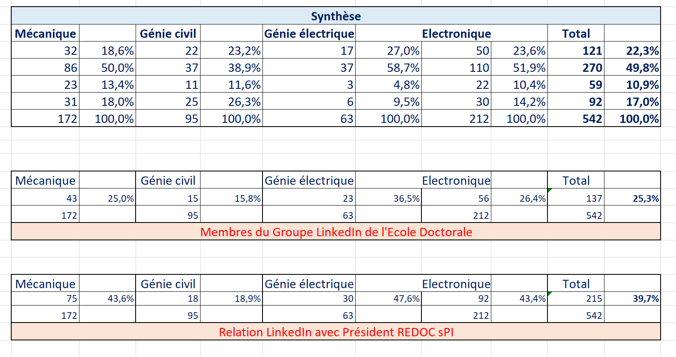
Information about professional insertion - ENGSYS
LinkedIn Group ENGSYS & MADIS
800 Members
An asset for strengthening our presence
PhD students and Doctors on LinkedIn
270 Doctors in company 215 different companies

Slide 23
Information about professional insertion - ENGSYS
LinkedIn Group ENGSYS & MADIS
800 Members
An asset for strengthening our presence
PhD students and Doctors on LinkedIn
TOP Employers | ENGSYS
STMicroelectronics | 11
EDF | 6
Safran | 6
Alstom | 5
CEA | 5
CEA-Leti | 4
Thales | 4
Capgemini Engineering | 3
Framatome | 3
imec | 3
RAILENIUM | 3
 | 53
TOP Employers Doctors ENGSYS 2017-2022
11 Employers
3 Doctors or more
53 ENGYS doctors
TOP1
STMicroelectronics

Slide 24
Information about professional insertion - ENGSYS
Groupe LinkedIn ENGSYS & MADIS
800 Membres
Un atout pour renforcer la présence
Doctorants et Docteurs sur LinkedIn
EOMYS | e-NVH simulation software, consulting, training and testing solutions
Groupe Institut de Soudure
Hitachi Astemo
Institut Pasteur de Lille
MC2 Technologies
NAVAL GROUP
NXP Semiconductors
Refact
RTE Réseau de Transport d'Electricité
Saint-Gobain Research Paris
Sopra Steria
UMS - United Monolithic Semiconductors
Valeo

Slide 25
Information about professional insertion - ENGSYS
Groupe LinkedIn ENGSYS & MADIS
800 Membres
Un atout pour renforcer la présence
Doctorants et Docteurs sur LinkedIn
Size | Electronics |  | Meca |  | Electrical engineering |  | Civil engineering |  | Total
GE | 48 | 44,0% | 41 | 47,7% | 19 | 51,4% | 5 | 13,5% | 113 | 42,0%
ETI | 28 | 25,7% | 21 | 24,4% | 7 | 18,9% | 9 | 24,3% | 65 | 24,2%
SMES | 33 | 30,3% | 24 | 27,9% | 11 | 29,7% | 23 | 62,2% | 91 | 33,8%
 | 109 | 100,0% | 86 | 100,0% | 37 | 100,0% | 37 | 100,0% | 269 | 100,0%
Doctors by company size

Slide 26
Make your PhD a success

